Slide 1

Counter Logic Gaming

Slide 2
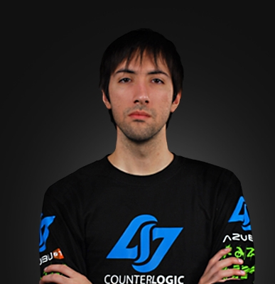
History
Founded by George “HotshotGG” Georgallidis in 2010
Started as only a LoL team with HotshotGG on the roster
A falling out between HotshotGG and Reginald spurred Reginald to start TSM.
LOTS of drama within the team’s roster
CLG’s first branch out was its DOTA 2 team lasting from Febuary 2012 to October 2012
Halo: November 2014 – October 2016

Slide 3

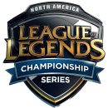

Current Teams and Players
League of Legends
Darshan, Aphromoo, Xmithie, HuHi, Stixxay
CS:GO
Hazed, reltuC, Koosta, nahtE, subroza
Super Smash Bros. Melee
PewPewU, SFAT
Super Smash Bros. Wii U
NAKAT, VoiD
CLG Red (Female CS:GO team)
potter, di^, bENITA, missharvey, klaudia, da_bears
League of Legends Challenger
Fallenbandit, Omargod, Tuesday, Zag, FIll

Slide 4
CLG’s Core Mission
“Our core mission is to help everyone associated with Counter Logic Gaming become the strongest versions of themselves, mentally, physically, and spiritually. Providing the best resources for players to grow as people will create the highest powered athletes on the competitive field. For this reason we hire passionate specialists in multiple fields to support our players across a broad discipline of skills. We take pride in creating a culture where nothing is primary over attitude. Our players and staff are the most driven and passionate in the industry. We’re an organization that is focused on execution above all else. We know how to put in the hours. We know that working hard is the largest competitive advantage you can have. The founding principle of Counter Logic Gaming is our deep connection with our supporters. We keep this alive by constantly searching for ways to connect our fans with our teams. Through our social channels we follow the journey of our players and tell their story. We connect supporters with meaningful moments. We host special events and build unique portals for our supporters to engage with our teams unlike any other esports team. ” – clgaming.net
Tldr; CLG works hard to make sure its players are treated right and have access to the resources they need to succeed.

Slide 5
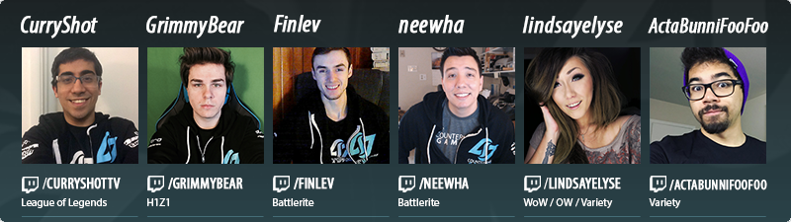
Recent Additions
Mike Schwartz – CS:GO Player Development Coach
Was previously the LoL Player Development Coach
Chet “ImAPet” Singh – CS:GO strategic coach
John Sipher – Director of Business Devleopment
Matt “Trinitiii” Nausha – Esports Director

Slide 6
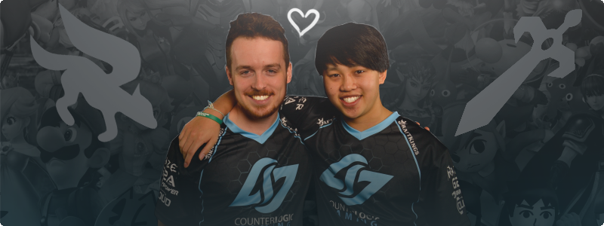
PewFat
One of the only Consistent doubles teams
First team both signed by the same org
Recently won:
EVO 2016
Get on my Level 2016
The Big House 6
UGC Smash Open

